Slide 1



A Love Letter to...
KiCAD ERC

Slide 2

You don’t really love the ERC
Electrical Rules Check
Reviewed KiCAD designs
  Found leftover ERC warnings
  Or unfairly waived ones
But ERC is so great!
  Protecting you from potential mistakes
  Let’s see why, and how!

Slide 3


About me
Eve Redero – redero.fr
Electronics and embedded engineer
10+ years XP in consumer electronics
~2 years KiCAD user
~5 years Altium
~1 year EagleCAD

Slide 4
Summary
What is ERC?
My top 5 ERC
How to get rid of this weird ERC message?
Pin types and connection matrix
ERC vs real life issues (with quizz)
KiCAD is V9

Slide 5
1- What is ERC
?

Slide 6

Electrical Rules Check
Set of heuristics related to the schematics and netlist
  If pin in component not connected,
  then ERC error
  If net not connected to anything,
  then ERC error
Similar to software warnings
1 What is ERC

Slide 7
What ERC is not...
Spice simulators:
  Solve electrical equations
  Integration with KiCAD
  LTSpice is another popular option
ERC do not run Spice!
  Or any kind of simulations
?
U=RI
q=LdI/dt
1 What is ERC

Slide 8
Why ERC?
« Most of the time, the consequences for ignoring warnings are nothing, no big deal.
However, many of the hard faults […] could have been found by enabling all compiler warnings and fixing each one.
Spend time removing the seemingly trivial compiler warnings so you can see the incredibly important ones. »
Elecia White, Making Embedded Systems (p261)
→ Same with ERC
1 What is ERC

Slide 9

3 real-life errors I have made
that could have been avoided with a better ERC usage
they where manufactured and I had to live with it until the next prototype run
and it cost my company money and time and everyone was mad
Power supply not connected because of a typo in net label
e.g. VDD_3V3 vs VDD-3V3
  → Microprocessor not powering up
Wrong footprint on a peripheral IC
  → No peripheral chip equipped, no possible rework
UART TX / RX inverted... twice
  → No debugging, no flashing
1 What is ERC

Slide 10
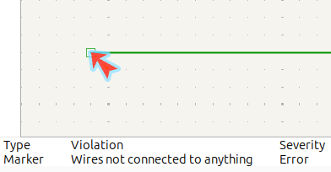
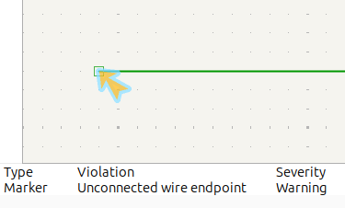
Run the ERC
Inspect → Electrical Rules Checker
Possible to assign key shortcut
Tip : ERC markers
  Can be moved or deleted
  Appear in the status bar
Run with command line (and in CI!)
  Kicad-cli (installed with KiCAD)
kicad-cli sch erc myfile.kicad_sch –format=json
  Kibot (third-party project)
kibot -c .ci/config.kibot.yaml
-e cad/myfile.kicad_sch
1 What is ERC

Slide 11
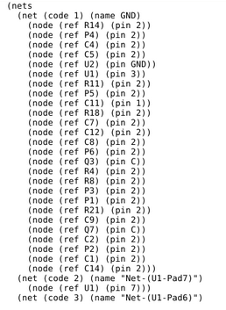
What is the netlist?
Under the hood, schematics get compiled in a netlist
List of nets and nodes connected to them
Transmitted to PCB Editor
1 What is ERC

Slide 12

2- My top 5 ERC
♫These are a few♬
of my favourite ERC
2 My top 5 ERC

Slide 13

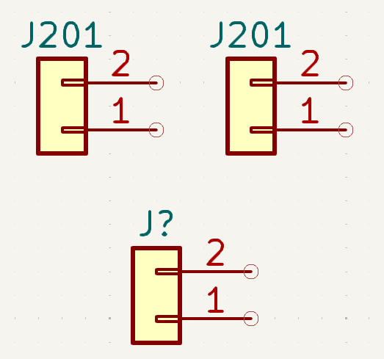
Annotations issues
5
Duplicate items
  Same annotation used twice
Item not annotated
  Annotation with « ? »
Netlist : generated based on symbols annotations
→ Annotation issues are bad
Tools → Annotate Schematics
ERCE_UNANNOTATED
ERCE_DUPLICATE_REFERENCE
2 My top 5 ERC

Slide 14
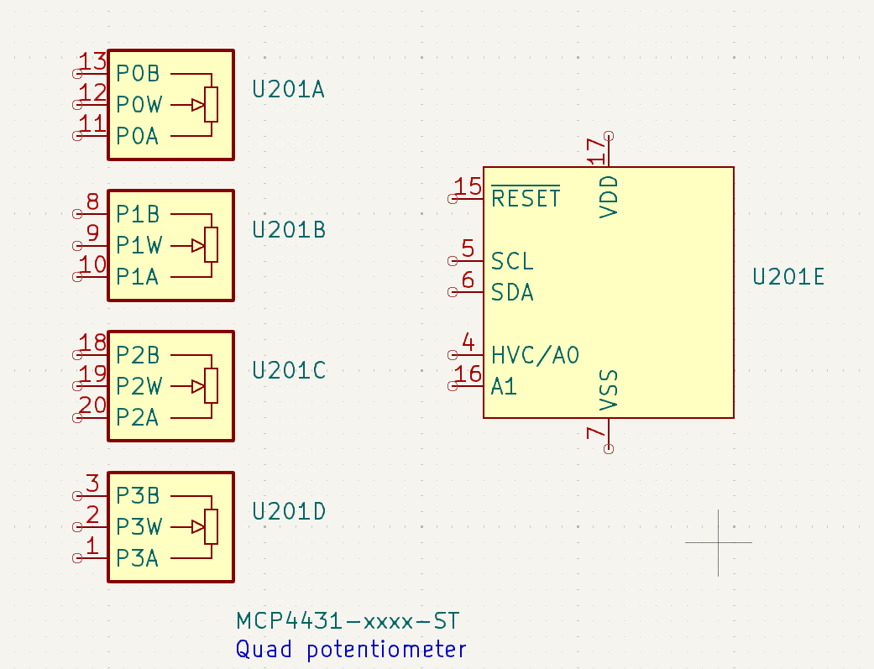
Missing part in symbols
4
“Symbols have unplaced units“
Several symbols, one component
  Powerful! Use it!
  Easy to forget one of those symbols
  Potential catastrophe: chip not supplied at all
ERCE_MISSING_UNIT
2 My top 5 ERC

Slide 15
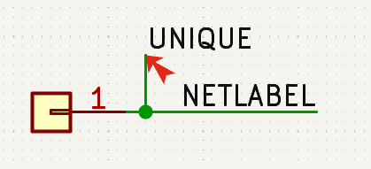
Multiple labels on a net
3
“Both X and Y are attached to the same items, X will be used in the netlist“
More than one name given given to this bus or net
In the netlist, only one net name is chosen
  Top of the hierarchy if hierarchical
  Otherwise, IDK
Annoying because lots of features depend on net names!
  Differential pair
  Bus membership
2 My top 5 ERC

Slide 16
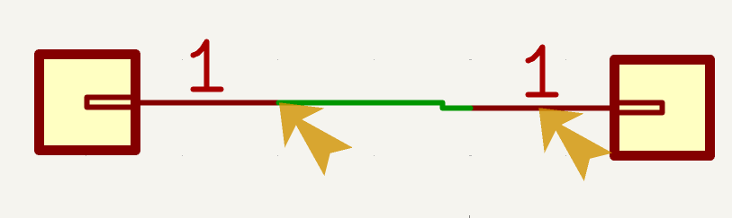
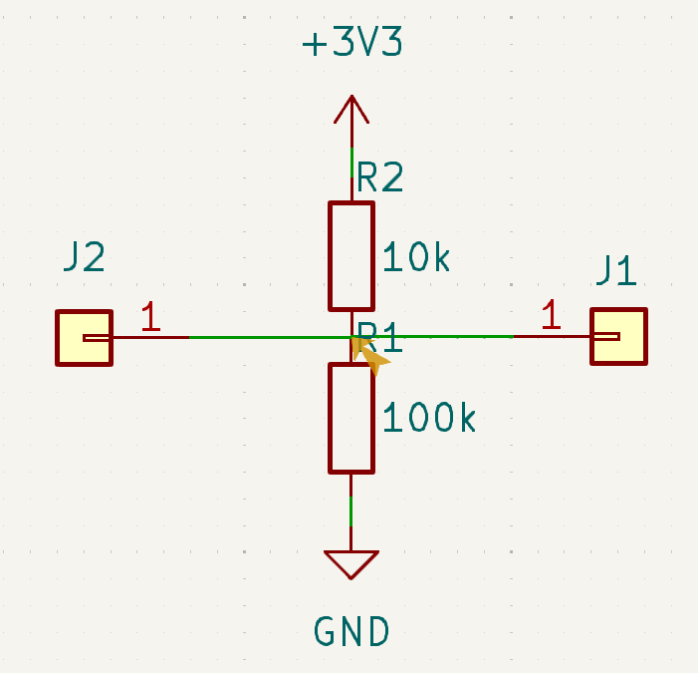
Offgrids
2
“Symbol pin or wire end off connection grid“
Offgrid is bad
  Objects need to be at the exact same coordinates to be connected
  Off grid things can be close enough to appear connected
Set up grid correctly
  50 or 100 mils
Use « Align Items to Grid »
If lib symbol is offgrid, burn the lib
ERCE_ENDPOINT_OFF_GRID
2 My top 5 ERC

Slide 17
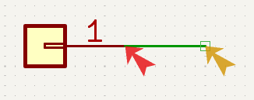
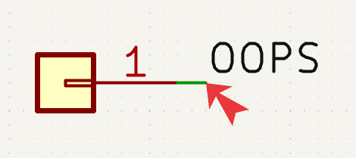
Pin / label not connected
1
“Pin not connected“
“Label not connected to anything“
Object is all alone in the netlist
Maybe you forgot a really important connection!
ERCE_PIN_NOT_CONNECTED
ERCE_LABEL_NOT_CONNECTED
2 My top 5 ERC

Slide 18
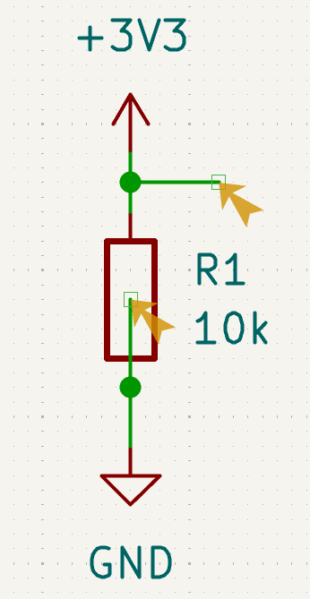
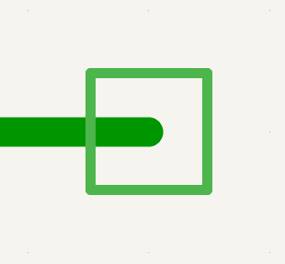

Not connected & loose ends
1.1
“Unconnected wire endpoints“
Graphical only, not compiled
Good friends with “Not Connected“ issues
Remove them all
ERCE_UNCONNECTED_WIRE_ENDPOINT
2 My top 5 ERC

Slide 19
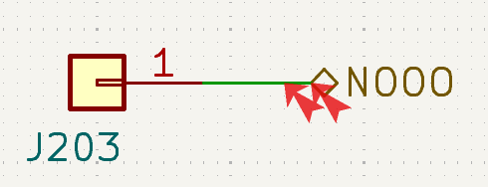
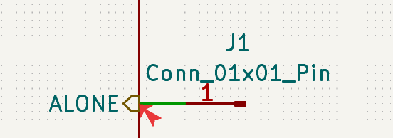
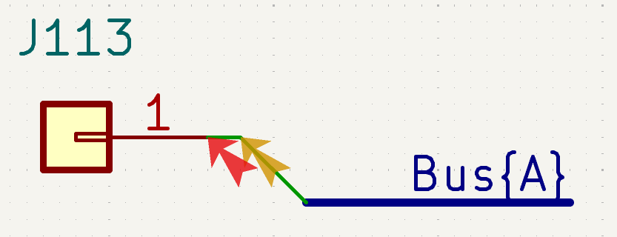
Not connected & fancy errors
1.2
Other ways to get a non-connected label:
“Hierarchical label has no matching sheet pin in the parent sheet“
“Sheet pin has no matching hierarchical label inside the sheet“
“Graphically connected to a bus not a member of that bus“
ERCE_HIERACHICAL_LABEL
ERCE_BUS_ENTRY_CONFLICT
2 My top 5 ERC

Slide 20
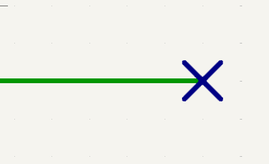

No connect flag
1.3
All pins and nets should be connected...
Unless explicitely exempt by a no-connect flag
- Visual indication
- Stamp of approval
If no-connect flag is connected,
it will raise an ERC too
ERCE_NOCONNECT_CONNECTED
2 My top 5 ERC

Slide 21
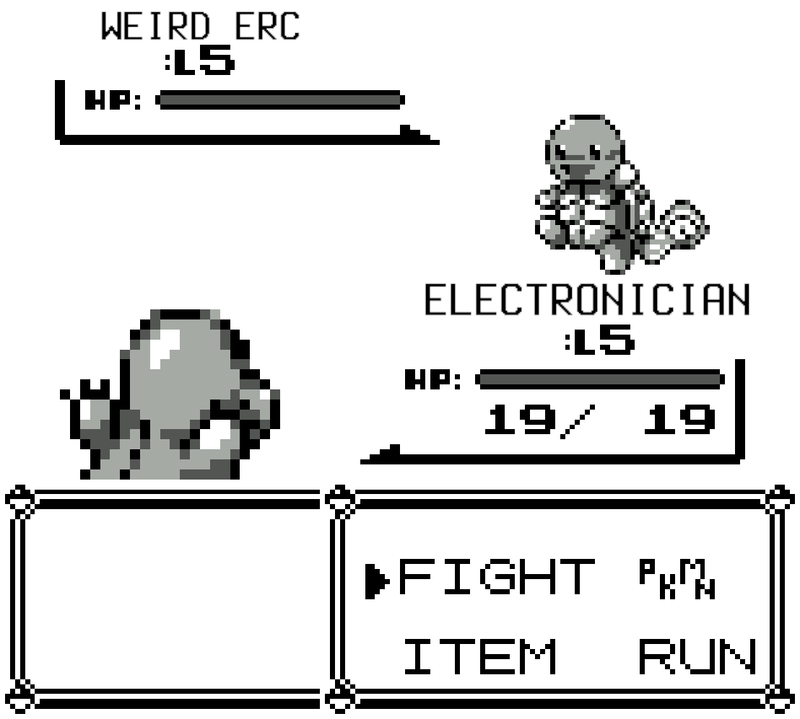
3- How to get rid of weird ERC messages?
Gotta clean them all!
3 Get rid of ERCE

Slide 22



Unresolved variable
A text with a ${VAR} is written, but no VAR is defined
Define VAR in the Text Variables submenu
Not in nets! ${NET} will stay ${NET}
ERCE_UNRESOLVED_VARIABLE
3 Get rid of ERCE

Slide 23
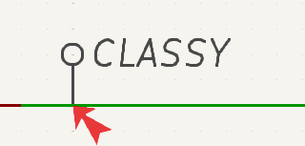
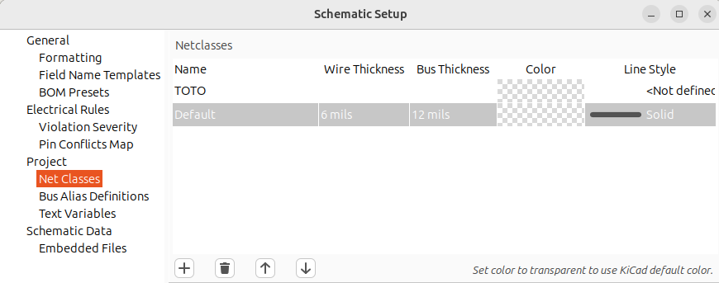
Netclass not defined
Invoke a netclass with a netclass indicator
Define the netclass in the Net Classes submenu
ERCE_UNDEFINED_NETCLASS
3 Get rid of ERCE

Slide 24
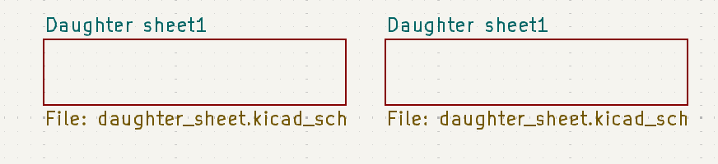
Duplicate sheets
“Duplicate sheet names within a given sheet“
Fixed in Sheet Properties:
  Sheetfile should be the same
  Sheetname should be different
ERCE_DUPLICATE_SHEET_NAME
3 Get rid of ERCE

Slide 25
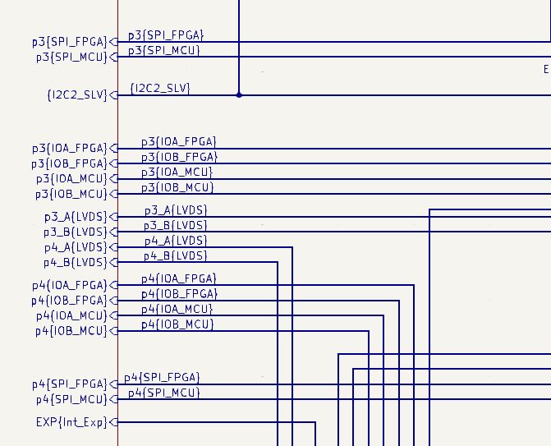
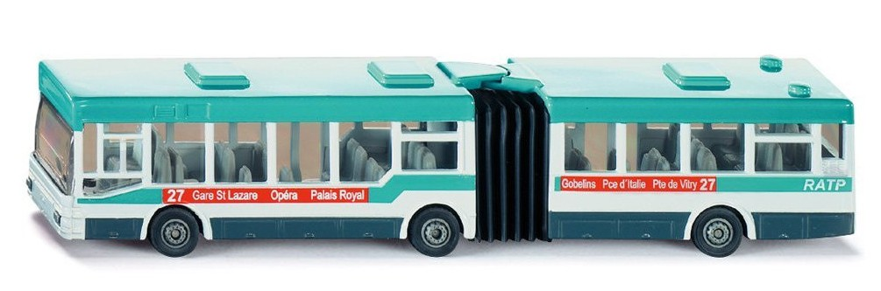
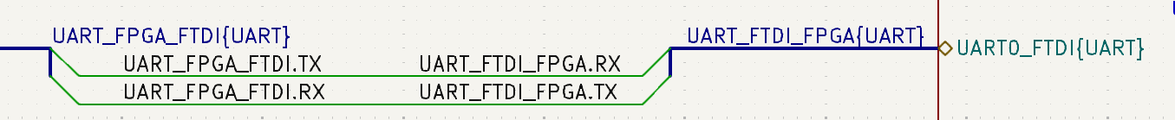
Careful with busses
Complex to use
Will raise lots of ERC
Use only if:
  ≥ 4 signals
  That need to go in > 2 places
3 Get rid of ERCE

Slide 26

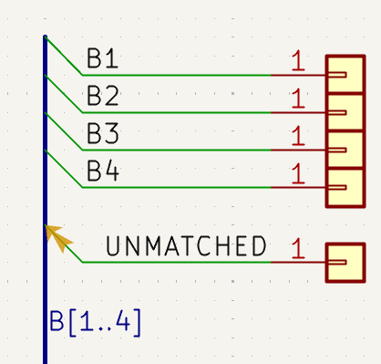
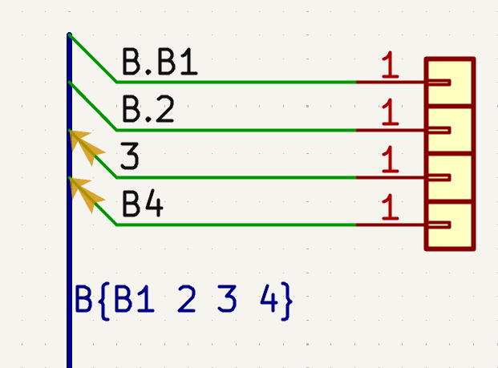
Bus entry issues
“Net X is graphically connected to bus Y
but is not a member of that bus“
Bus label syntax is wrong
Net name does not match bus label “regex”
ERCE_BUS_ENTRY_CONFLICT
3 Get rid of ERCE

Slide 27
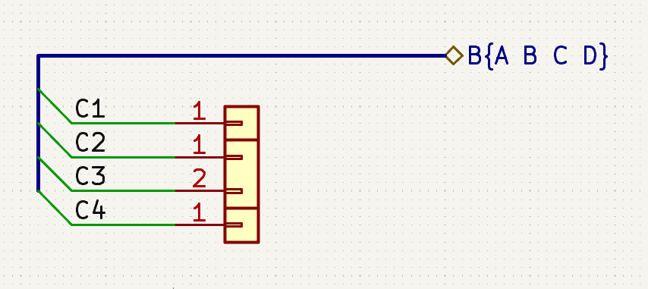
Bus entry issues issue
“Bus entry issue” ERC not raised in daughter sheets (V9)
  Bug #19646 recently fixed
Check your “Label Not Connected” issues instead
3 Get rid of ERCE

Slide 28
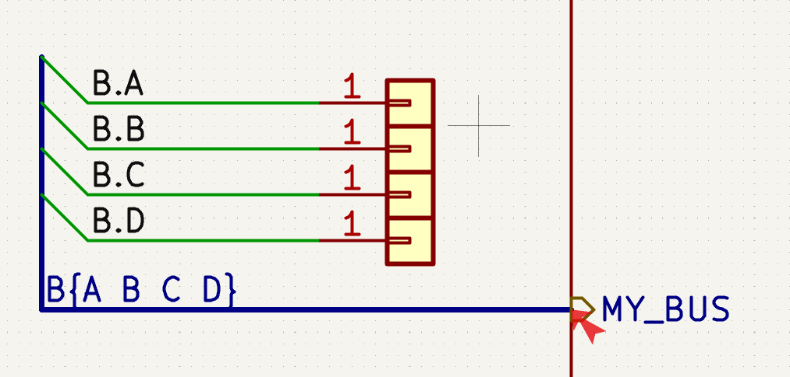
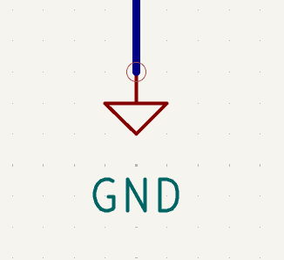

Bus to net conflict
“Invalid connection bus and net items“
Bus name and hierarchical port name are different
Something weird with power symbol (rare)
ERCE_BUS_TO_NET_CONFLICT
3 Get rid of ERCE

Slide 29
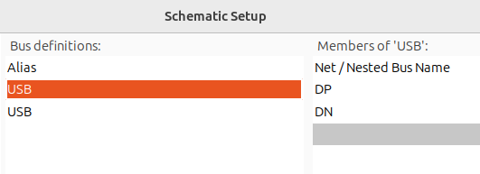
Bus alias definition conflict
“Bus alias X has conflicting definitions on sheet1.kicad_sch and sheet2.kicad_sch“
Bus aliases are variables stored in kicad_sch files
2 schematics can have the same bus alias defined
Remove one of the definitions from a schematics in Schematic Setup → Bus Alias Definition
ERCE_BUS_ALIAS_CONFLICT
3 Get rid of ERCE

Slide 30
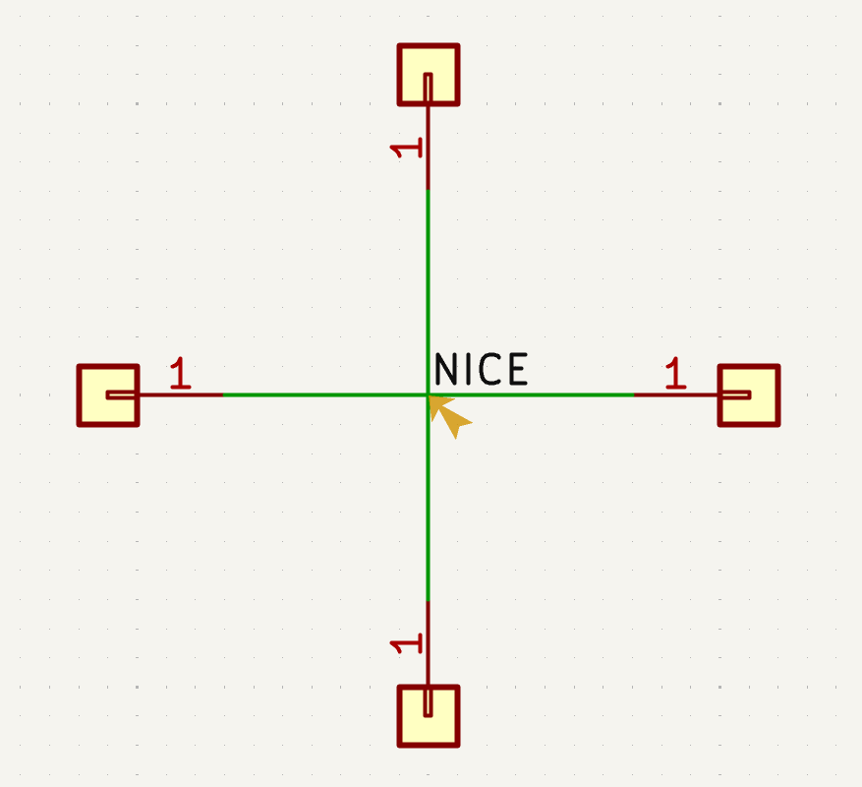
How do you even?...
“Label connects more than one wire“
Label on multiple wires
Happens when the label "hitbox" is on a non-connected intersection
ERCE_LABEL_MULTIPLE_WIRES
3 Get rid of ERCE

Slide 31
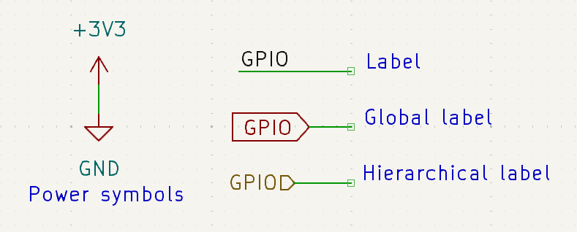
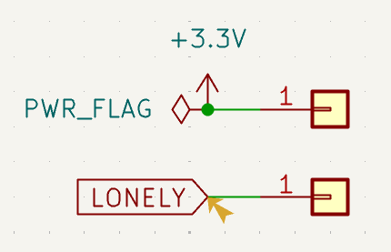
Global labels not connected
“Global label not connected anywhere else in the schematics“
Lonely global labels will trigger an ERC
Lonely power symbols will not
3 Get rid of ERC
3 Get rid of ERC
ERCE_SINGLE_GLOBAL_LABEL
3 Get rid of ERCE

Slide 32
4- Pin types ERC
The “Power Input needs Power Output” ERC
and the Dreaded Connection Matrix
4 Pin types ERC

Slide 33
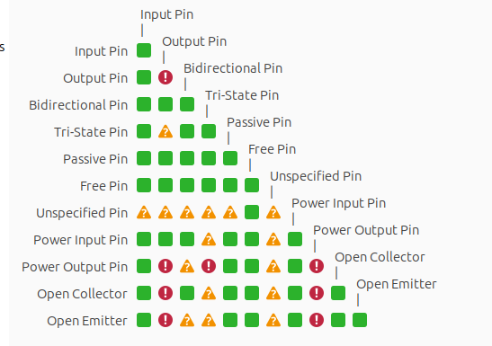

Connection Matrix
Each symbol pin or hierarchical label has a type
Some types are not compatible with one another
  Outputs x Outputs
“Pins of type X and Y are connected”
  Goal: avoid conflicts
  Still not a SPICE simulation!
4 Pin types ERC

Slide 34
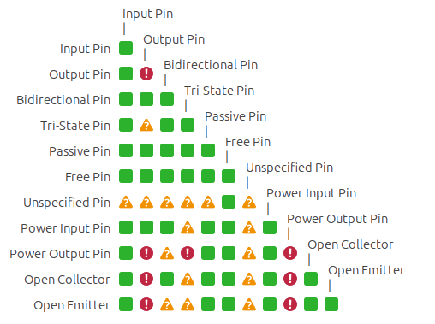
Special pin types
“Unspecified” always gives warnings
“No connect” can never be connected
“Free” never gives warnings, but can be connected. Can be used for no-connect pins
“Passive” is ideal for non-driven pins (connectors, passive components...)
All explained in : https://docs.kicad.org/9.0/en/eeschema/eeschema.html#pin-electrical-types
4 Pin types ERC

Slide 35
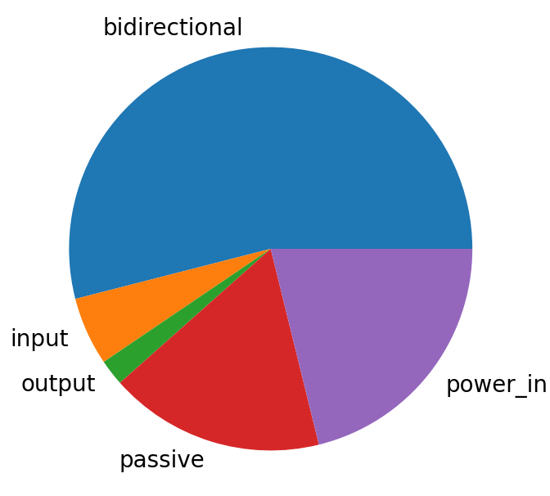
Pin types popularity contest
bidirectional | 282556
power_in | 110717
passive | 90425
input | 28665
output | 10924
no_connect | 4259
power_out | 2896
tri_state | 1633
open_collector | 1565
open_emitter | 113
unspecified | 33
free | 25
KiCAD V8 standard library pin types (<1% hidden)
4 Pin types ERC

Slide 36

Special ERC for inputs
Input pin types are special!
Input pins : need to be driven
  Output
  Power output
  Passive
  3-State
  Bidirectionnal
« Input pin not driven by any output pins »
Power input pins : need to be driven
  Power output only
« Input power pin not driven by any power output pins »
ERCE_PIN_NOT_DRIVEN
ERCE_POWERPIN_NOT_DRIVEN
4 Pin types ERC

Slide 37
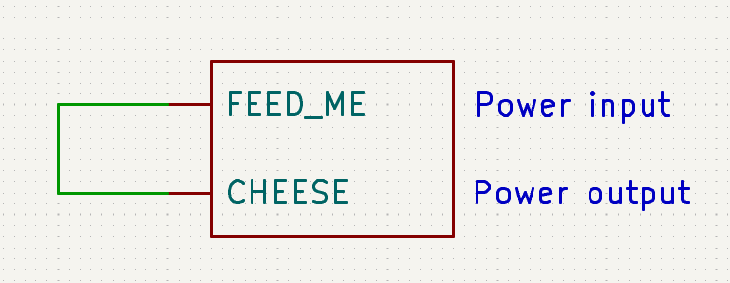
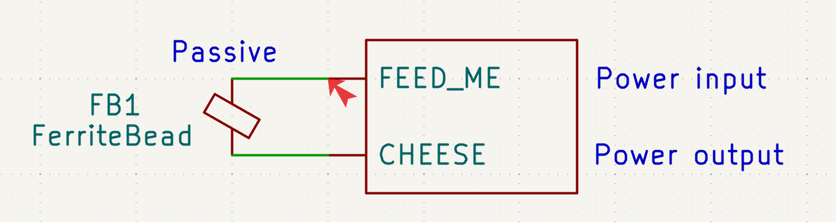
Power input issue #1
“Input power pin not driven by any output power pins”
What about power from passive pins (ferrites, connectors…)?
What about third-party, non-optimal libraries?
4 Pin types ERC

Slide 38

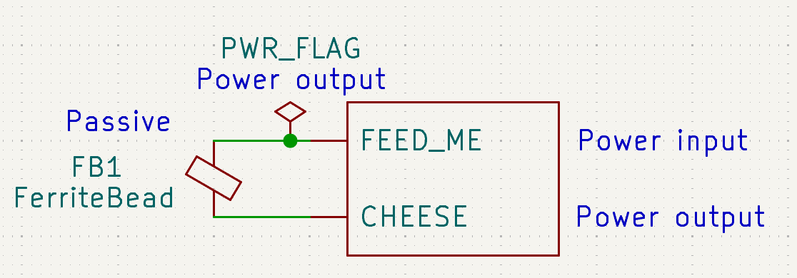
Power output flag
Add the Power Output flag!
  But not randomly
  Add it where the power comes from
4 Pin types ERC

Slide 39
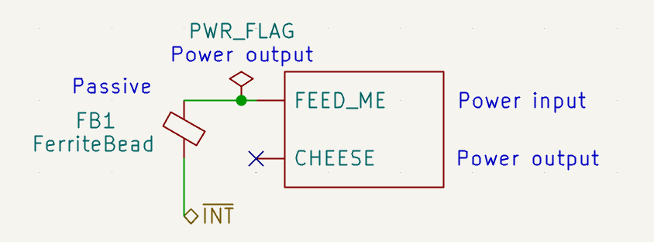
Power input issue #2
Now the PWR_FLAG hides an issue...
The ferrite not being supplied by any power output
4 Pin types ERC

Slide 40
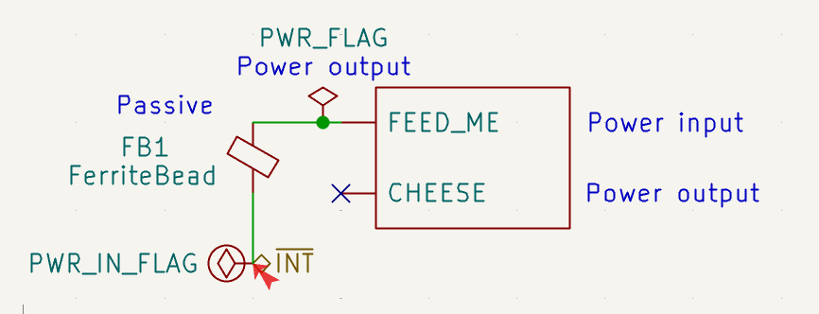
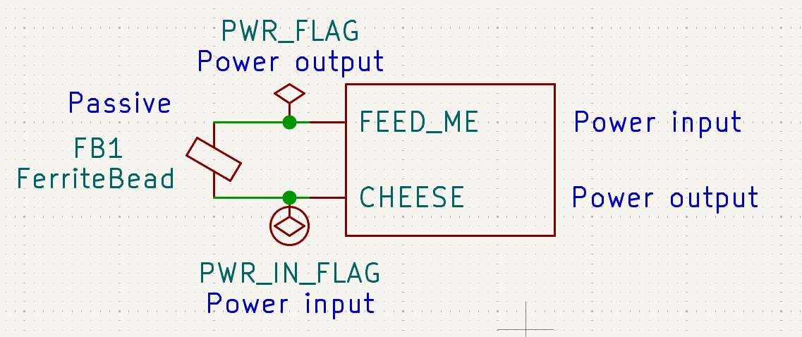
Power input flag
Create a custom Power Input Flag!
It’s just a component with a power input pin
Tip : Uncheck the “power symbol” option
4 Pin types ERC

Slide 41

5 - ERC versus real life issues
+ Quizz: guess the ERC
5 ERC VS life

Slide 42
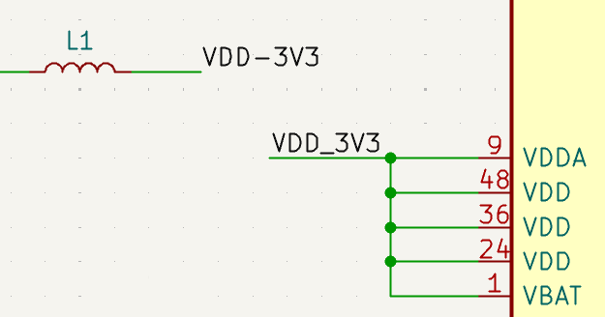
#1 Power supply typo
Which ERC will pop in this case?
5 ERC VS life

Slide 43
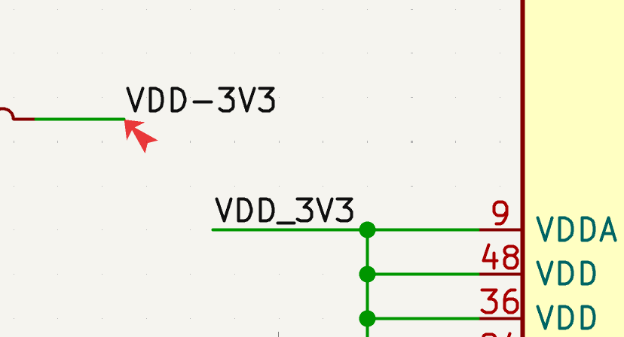
#1 Power supply typo
“Label not connected to anything”
1

Slide 44
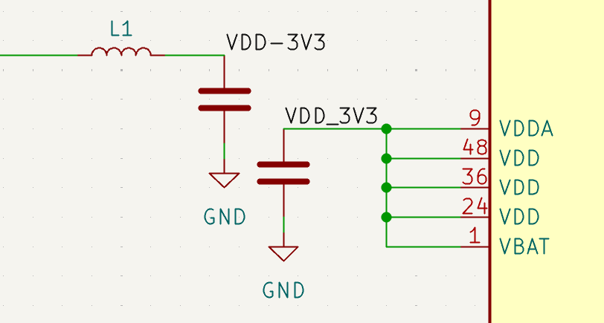
#1 Power supply typo
Which ERC will help now?
5 ERC VS life

Slide 45
#1 Power supply typo
"Input power pin not driven by any output power pins"
VDD pins are power input, without a power output!
5 ERC VS life

Slide 46
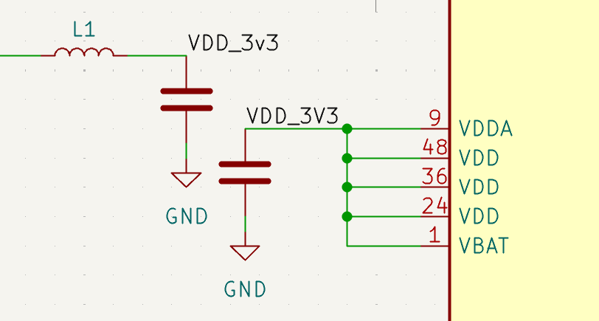
#1 Power supply typo
What about now?
Another cool ERC maybe?
5 ERC VS life

Slide 47
Suspected typos
KiCAD is case-sensitive
  3v3 is not 3V3
ERC only catching case oopsies
ERCE_SIMILAR_LABELS | 2 labels are equal for case insensitive comparisons.
ERCE_SIMILAR_POWER | 2 power pins are equal for case insensitive comparisons.
ERCE_SIMILAR_LABEL_AND_POWER | Label and pin are equal for case insensitive comparisons.
ERCE_SAME_LOCAL_GLOBAL_LABEL | 2 labels are equal for case insensitive comparisons.
5 ERC VS life

Slide 48
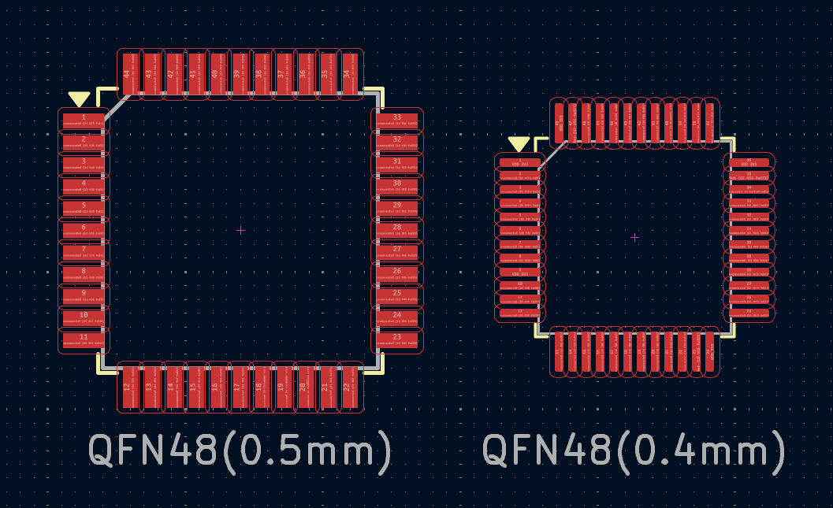
#2 Footprint mismatch
Wrong footprint on an IC
  The trap: QFN pitch
  Read datasheet carefully
Do you know an ERC
that could help?
5 ERC VS life

Slide 49
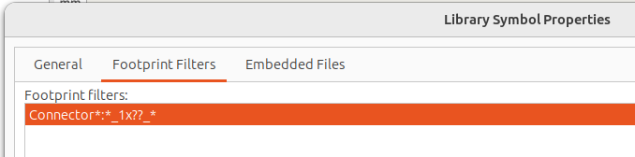
Footprint filters
“Assigned footprint X doesn’t match footprint filters “
Footprint filter
  Simplified regex, only * and ?
  Defined in symbols
  Different from the “Footprint” field
  ERC disabled by default
Example STM32F722ICTx:
Footprint: LQFP-176_24x24mm_P0.5mm
Filter: LQFP*24x24mm*P0.5mm*
5 ERC VS life

Slide 50
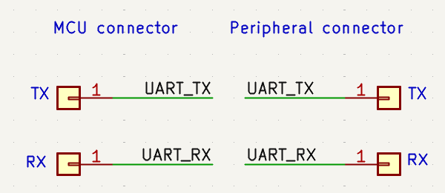
TX / RX inversion issues
Infinite variations on a theme
Simply forgotten
Split on different pages
Interverted several times
What could we do?
5 ERC VS life

Slide 51
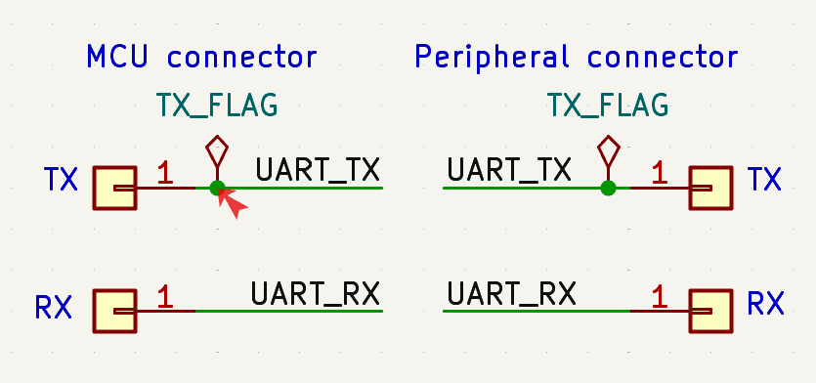
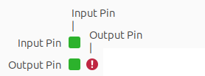
#3 TX / RX inversion issues
Rename them MCU_TO_PERIPHERAL / PERIPHERAL_TO_MCU
Create an “Output Pin” flag to flag TX
  2 output pins are exclusive
  Inversion issue : “Pin of type Output and Output are connected”
Use the alternate pin feature!
5 ERC VS life

Slide 52


TX/RX inversion issues
New feature in V9:
Alternate pins set up in symbol
Each alternate can have its own electrical type
Change your TX alternate to “Output“!
5 ERC VS life

Slide 53
Conclusion
Learn to use all the ERC you can!
Clean up all the noise to be warned of anything suspicious!
Analyze your mistakes and find ways to detect them!
KiCAD is open-source: participate!

Slide 54
References
Full documentation about ERC
https://docs.kicad.org/9.0/en/eeschema/eeschema.html#list-of-erc-checks
KiCAD bug tracker
https://gitlab.com/kicad/code/kicad/-/issues
Actually Useful Schematics in KiCAD, by Andrew Greenberg
https://www.youtube.com/watch?v=X0hd_v8qRiY
Popularity contest for QFN/QFP pitches
https://www.flashpcb.com/blog/QFP-QFN-Miniaturization

Slide 55
Thank you !!!
Question time !

Slide 56


ERC vs Physics
According to KiCAD:
  GND is a Power Input pin (all GND are)
  -15V and +15V are Power Output pins
According to Physics:
  Current flows from 15V to GND
  Current flows from GND to -15V
ERC only checks:
  One and only one power output pin per net
  If there is a power input pin, there should be a power output pin
  Does not care about the actual current flow direction
4 Pin types ERC

